Slide 1
Science at Banwell
Expectation in recording
scientific learning

Slide 2
Required practicals
Each term, (6 times a year) children will complete a required practical for the unit that that they are currently working on. The details of the practical are laid out in the medium term planning documents.
With a required practical, children are expected to complete and record the whole scientific process as outlined in the slides below. With other practical sessions, it may be more appropriate to only record part of the process in detail.
Teachers are encouraged to teach practical sessions regularly. In some cases it will be more appropriate for the teacher to undertake the practical work – particularly where a known fact is being demonstrated (e.g., that salt can be separated from water by evaporation) and where it will be easy for a child to not recreate the expected result, leading to a misconception. Children should be given the chance to explore in an individual practical activity where a genuine uncertainty exists in the results, or where patterns can be observed.

Slide 3
Recording practical work
Children should be able to record their practical work in writing, using the agreed format:
Question
Prediction
Method (usually as an image)
Results
Conclusion (answer the question)
Evaluation (what went well, what to change, what to investigate that is related next)
Practical work should take almost all of the science lesson – writing up the practical should either be separated into a writing session with a focus on accurate non-fiction writing, or some elements should be written up by the teacher where appropriate.
The example below, is a full example from the 2018 DfE science assessment exemplification document: https://assets.publishing.service.gov.uk/government/uploads/system/uploads/attachment_data/file/763065/2018_key_stage_2_teacher_assessment_exemplification_science.pdf

Slide 4
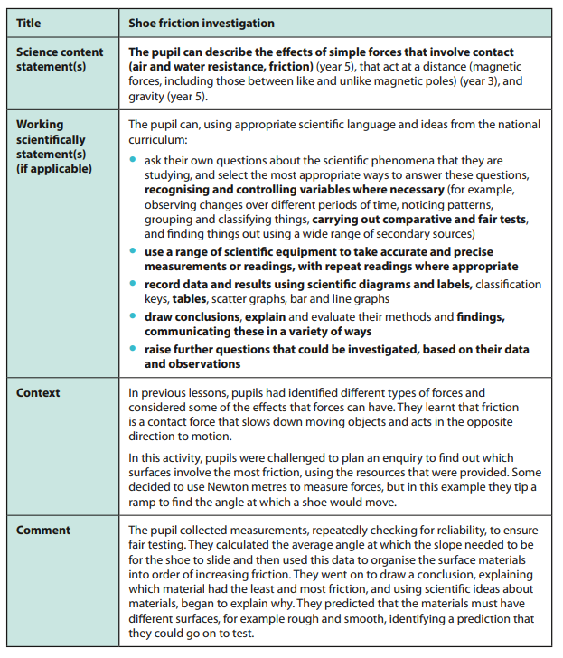
Teacher information
This investigation is from the KS2 Science exemplification materials published by the DfE in 2018.
At Banwell Primary, we would expect this level of detail and presentation, but not every element of the investigation to be written by the pupil for every lesson, or the focus is too heavily writing-based. Be clear as to which element you wish the pupils to focus on and where appropriate, type up other elements of the investigation prior to the lesson.

Slide 5
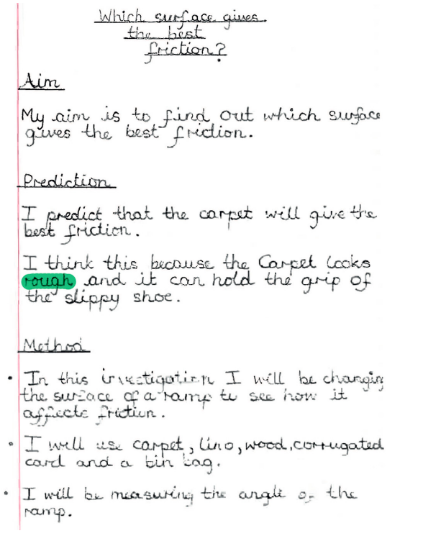
WALT: Carry out a fair test (Science)
At the top of the page, include a WALT, and the word (Science) in brackets so that children are clear that this is the subject that they are learning.
Use the school’s marking policy in Science, as in other lessons. If you highlight a word, make sure that you have verbally explained how it could be improved.

Slide 6
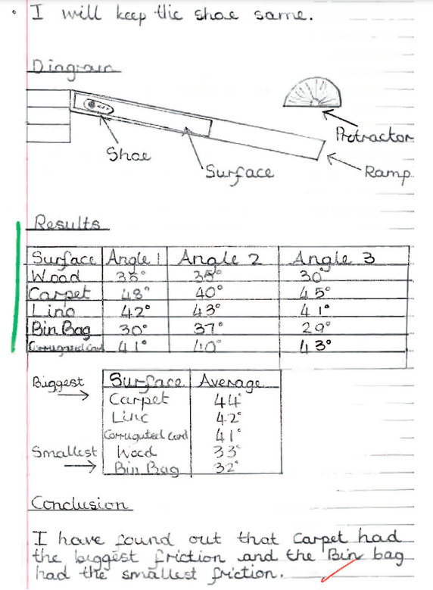

Slide 7
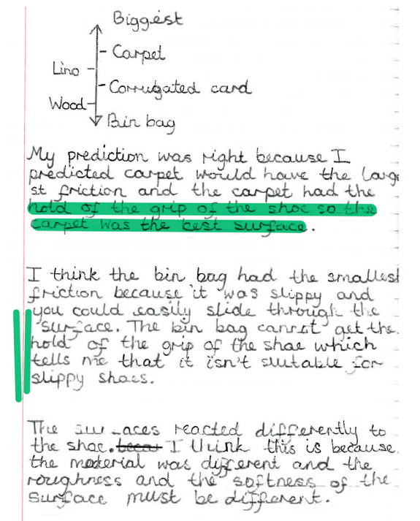

Slide 8
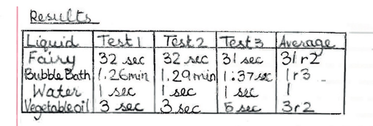
Examples of tables of results:
This again is an example from the 2018 booklet. Whilst the idea of calculating an average is a good one, I don’t think that the results here have meaning or demonstrate understanding. We should expect results that children can explain to us.
In KS2, we should build to the point that by the end of Year 3, children can draw their own tables and add their own labels. This will need to be explicitly taught and practised. Some children will continue to need support with this throughout KS2 and may need to have tables drawn/printed for them.

Slide 9
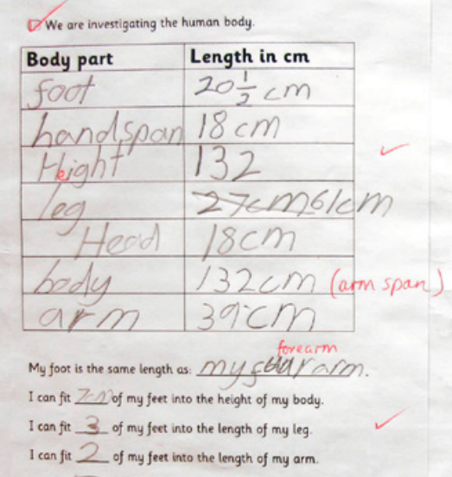
Examples of tables of results:
KS1 – provide the table and key labels, with the expectation that children complete the gaps.

Slide 10
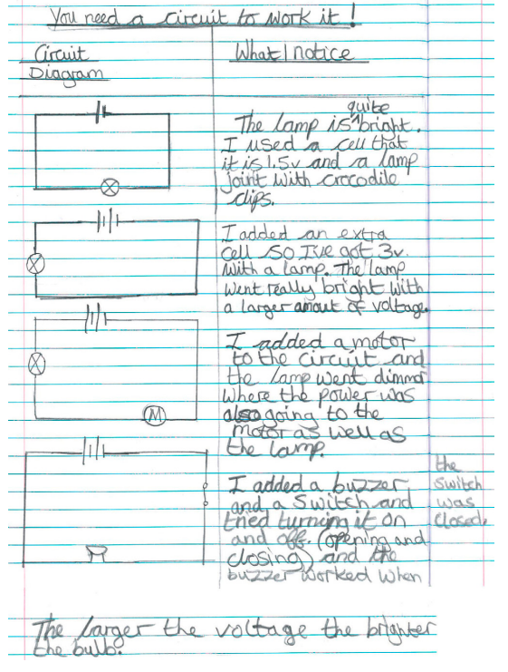
Examples of observations
KS2 – children describe observations as a narrative where applicable.

Slide 11
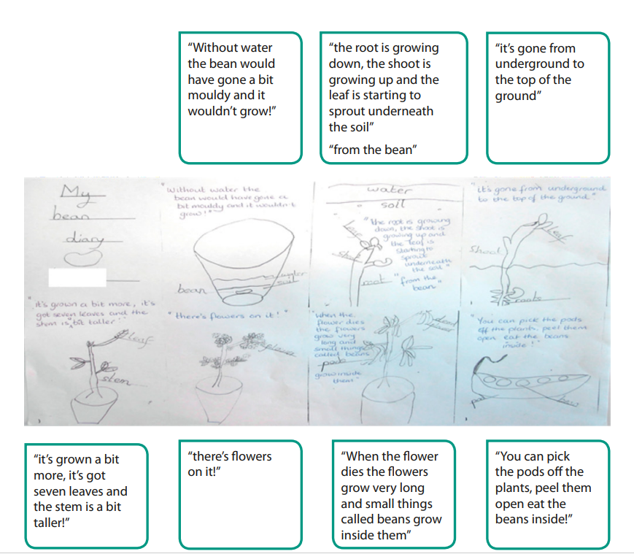
Examples of observations
KS1 – lots of diagrams (not pictures – explain that pictures illustrate, whilst diagrams help us to understand)

